Slide 1

Predator Prey Models with Python
ELECTRICAL AND COMPUTER ENGINEERING, COLLEGE OF ENGINEERING AND APPLIED SCIENCE

Slide 2
Goals
We will investigate creating a predator prey model using the graphical interfaces of python

Slide 3
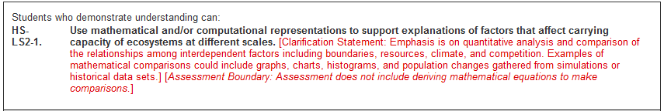
Applicable Education Standards
See page from Next Generation Science Standards:
https://www.nextgenscience.org/pe/hs-ls2-1-ecosystems-interactions-energy-and-dynamics

Slide 4
Abstract
Predator prey models are used to analyze the interaction between predator and prey species in an environment.

Slide 5
Materials
The only thing we need for this project is the Raspberry Pi itself
We need to download the matplotlib library which we will be using for plotting in python
This is accomplished by typing the following code into the terminal window and pressing Y when prompted:
sudo apt-get install python3-matplotlib

Slide 6
Materials
This will also install the numpy library which allows access to many regular mathematical operations

Slide 7
Setup
Once that library finishes installing you can open up Thonny or Python 3 for this project.
Create a “New File” and save it as what you want in this case I named my project PredatorPreyModel.py

Slide 8
Initializing the Variables
Before starting we need to import the numpy and matplotlib libraries with:
Then we need to create the variables we will be using in this project
We need variables to track predator and prey populations as well as initial parameters of the population characteristics

Slide 9
The Equations
The equations used in this project are based of a Lotka-Volterra equations
While there are other predator prey models, this is the most widespread and is not particularly difficult to implement
However it does require a slew of variables for operation so we will need to setup all of those next

Slide 10
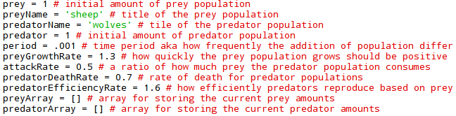
Initializing the Variables
We need variables to keep track of prey, predators, as well as the equation variables
Type in the code below to initialize all the variables we will use in this project:

Slide 11
Creating Functions
Now we need to determine our differential equations for the predator and prey populations
To do this we will use a function setup so we can call the operation later
The predator Equation is given below:

Slide 12
Creating Functions
We also need to create the differential for the prey population given below:
Now we can create the main loop which will calculate the changed differentials for prey and predator populations and add them to the actual populations

Slide 13
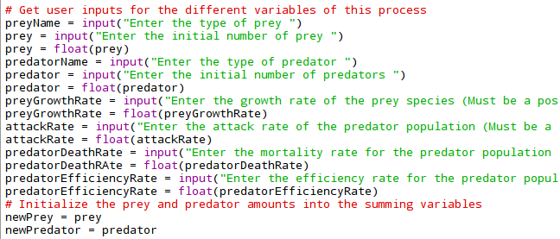
Checking for User Input
Now ideally we want the user to be able to provide all the variables for the equation
To accomplish this we use the input function to get data from the user to use in the plot
The code for this is given below:

Slide 14
Calculating Population Changes
Since the functions only give differentials to be able to plot them we need to recalculate the differential every time period and add it to the previous population amounts
Also since we want an entire graph we need to do this 10000 times to fill up the graph with population information

Slide 15
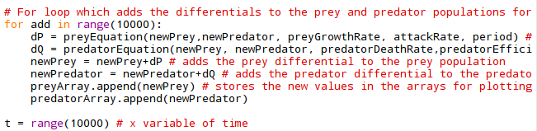
Calculating Population Changes
To accomplish both of these we use a for loop and add the differentials to populations amounts for each species and then store them in the arrays we created earlier this is displayed below:

Slide 16
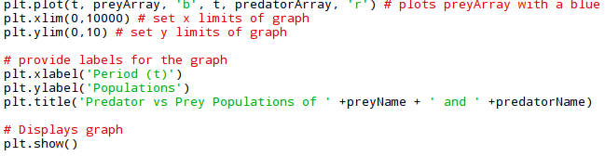
Plotting the Data
Now we have all our data created we need to plot it
To accomplish this we will be using some matplotlib functions
Initially we need to plot the values with:
This will plot the prey values on a blue line and predator values on a red line

Slide 17
Plotting the Data
Now we need to provide axis labels for our plot as well as display the actual plot
This is accomplished with the following code (the plot function is included for reference) :

Slide 18
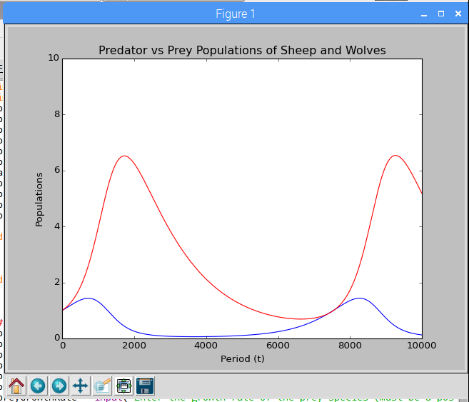
Checking the Plot
At this point you should be able to run the code and see a plot like this:
Remember that these equations can go unstable so if you use different input values from the code your plot may go to infinity

Slide 19
Improvements to Design
At this point we have a working plotter for the predator prey model
However it might be interesting to see the plotted information in real time
Subsequently, we will investigate animating our plot and using a carrying capacity variable in our equation to stabilize our plots
At this point save your current work, open a “New File” and copy the previous code that you wrote into it

Slide 20
Carrying Capacity
The standard equation does not have a carrying capacity variable
Thus the prey population can increase to infinity if the conditions are correct
Since this is impossible we will implement a carrying capacity variable to emulate the carrying capacity of an environment as well as increase the nominal stability of our plots

Slide 21


Carrying Capacity
First in our variables section we need to initialize a carrying capacity variable:
Once that is finished we need to modify our preyEquation to accommodate the new variable and use it
this can be done with the code below were K represents the carrying capacity variable:

Slide 22

Animation Setup
For setting up animation we first need to import another library:
After this we need to create two new arrays for the animating process:
Also since we want our animation to run faster lets change our period variable to 0.1:
We will now be using matplotlib’s FuncAnimation function so we need to setup some functions in preparation to using that

Slide 23
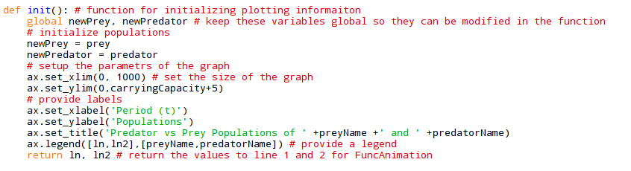
Animation Setup
The initialize function sets up the plotting scheme and parameters and will initialize the legend for the lines we will be plotting code is below:

Slide 24
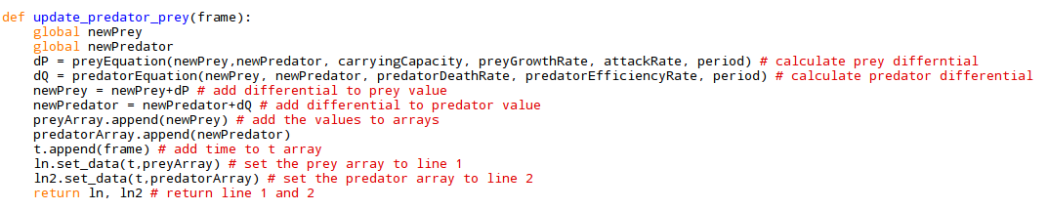
Animation Setup
After init function we need an update function which will essentially do the work of our for loop in the previous steps of this project by calculating populations and returning the arrays with the population amounts to line 1 and line 2 to be plotted:

Slide 25
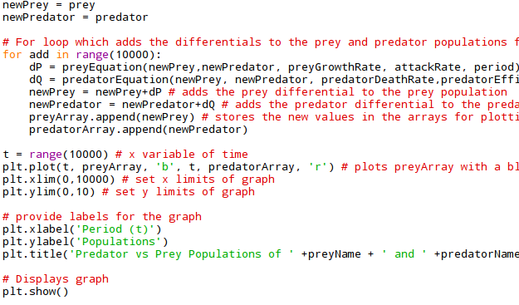
Animating the Plot
At this point we need to delete some lines from our previous code; find the code given below and delete it:

Slide 26
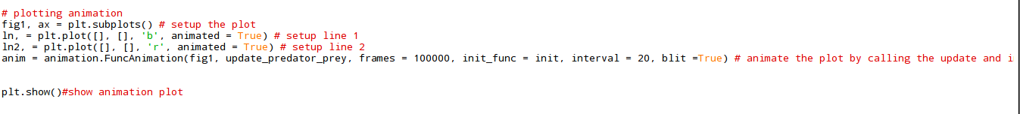
Animating the Plot
Once that is deleted we will use the few lines which should run the animation based on our init and update function:
With that complete you should be good to try plotting the graph and checking for any errors
The plot should be generating in real time across the screen

Slide 27
Improvement Ideas
This introduces plotting with python however there are a few issues
If the plot goes unstable how can you tell or stop it?
Can you limit the ranges of user inputs that are viable?
See if you can implement these things or any new ideas you may have

Slide 28
Conclusion
Finished code should be included so if you’re having any problems you can use that for reference
If you have any questions, feedback, ideas, or need help with the project feel free to email us at esp4t_tech@uwyo.edu

